Slide 1

Lecture 2
Automated Testing Basics
Notes:
Hi everyone, in this lecture we’re going to look at automated testing. By the end of this lecture you’ll know a bit more about what test automation is, why its important and you’ll have the chance to get some hands on experience with automated testing with javascript

Slide 2

A G E N D A
Automated Testing Overview
Automated Testing Types
Writing Unit Tests in JS
Notes:
This lecture will be broken down into three main sections.
First we will gain a general understanding of what test automation is.
After that, we look at some of the different types of automated tests
And finally we’ll look at learn about how to actually build javascript unit tests before trying it out in the assignment

Slide 3
Automated Testing Overview
Notes:
First lets take a look at the traditional software testing process, the challenges it poses and how automated testing can solve many of these challenges

Slide 4



What is Software Testing?
Ensure:
Old feature are still functioning properly
New features are working as expected
Previous bugs are fixed
Can be done manually and/or automatically
Notes:
So what is software testing exactly? In the world of software development, software testing is the process of ensuring that
(the points should come up one by one)
Old features are still functioning properly. By that we mean, that any new features or functions we have added to the existing software have not broken any of the existing features. Software development is a very precise art and unfortunately even the smallest change somewhere could have a cascading ripple effect through the entire system.
We also use testing to ensure New features are working as expected, once you have confirmed that the new features have not broken the old ones, you need to test that the new feature behaves as expected, for example, if you’ve added a feature to upload a profile picture, you need to test that the images can be uploaded, that they are stored and resized correctly, that they can be changed or deleted, and that they can be viewed correctly on different devices and browsers etc
Sometimes, Maybe you haven’t added any new features at all, maybe you’ve just fixed bugs in the existing system, the same rules apply here, you need to make sure first that fixing the bug has not broken existing functionality, and then test that the bug has actually been fixed correctly and that the related feature works as expected.
All these steps can be done manually or automatically. A lot of companies often do both for extra assurance. They will automate as much as possible, hopefully automated all of it. But also select some features to test manually as an additional quality assurance check.

Slide 5



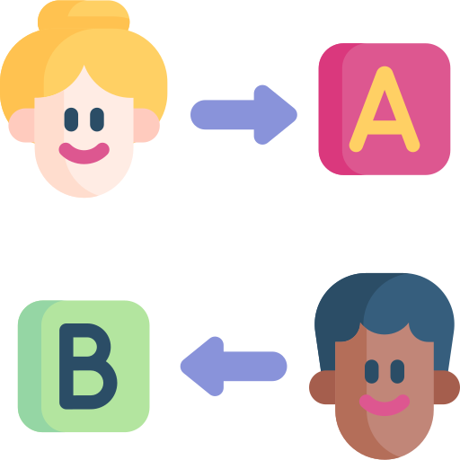
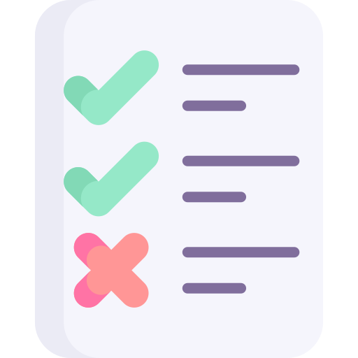
Traditional Software Testing Process
QA Team
01
02
03
04
Create testing plan
(test cases)
Break down test cases into smaller “packs”
Assign each team member a test packs and test the software manually
Share the testing report to software engineering team
Notes:
(The points should show up one by one using animation)
Traditionally, software releases are tested by humans, manually. This is done every time a new release happens.
The testing process is broken into a number of steps, all of which are organised and coordinated by the Quality Assurance team, or QA team in short.
These steps usually follow the pattern of
first, Study the system requirements and the desired outcomes of a release and then come up with a number of tests cases based on this content.
then, we will Break down the test cases into smaller test case packs or groups
thirdly, we will Assign these test case packs to different team members and have each of them test the different features manually. This means opening up the software and clicking buttons, simple data entry by typing on screen etc
finally, the QA team would Create a report based on the testing carried out. This report highlights any bugs or issues found and is sent back to the development team to address.
After receiving the testing report, the software engineers will then work on the bugs and issues. In the meantime, the QA team will Wait for bugs to be fixed and issues to be address and repeat the entire process again

Slide 6

Problems with Traditional Testing
Slow - there are thousands of test cases that QA team need to manually run and click one by one
Low Coverage - given the limit of time constraint, usually the team can only cover the popular features but not everything buttons in the software
Expensive - human resources are expensive and the manual process is very boring
Notes:
You can probably already guess what the problems are with this traditional testing approach.
(the points should show up one by one)
The approach is very time consuming. A relatively simple feature could have many use cases and each case could require complex ui navigation with multiple clicks, dropdowns and very specific data entry. Imagine how long it would take to manually test 100 different features that required this sort of effort. The answer is a very long time.
Because of how long it would take and how little time a testing team has to complete its work, test coverage is often very low. QA teams are forced to pick and choose the most popular or heavily used features to test. The danger here is that new features may have broken older functionality without the test team realising it.
Time is money, and unfortunately testing takes a lot of time and therefore costs a lot of money. We asked before how long would it take to test 100 different features, imagine now how much that would cost. This sort of repetitive tasks would also be very boring for a qa team member and may lead to job dissatisfaction or even the team taking shortcuts to complete tests quickly and missing critical bugs.

Slide 7

Automated Testing as a Cure
Minimal Human Efforts - Have the computer to click the buttons instead of human clicking the buttons
Short Testing Time - Computers can “click” the buttons a lot faster than human
Reusable Test Cases - Automated testing process can be “saved” and reuse every time
Notes:
Automated tests are the answer to the time, coverage and cost problems. Instead of clicking through the buttons and tedious data entry, have a computer click the buttons and type the required text.
(the points should should up one by one)
Computers do not get tired, do not get bored and do not make mistakes. When a test is defined in code you can be sure that every time the test is run, the exact same steps will be carried out in exactly the same order.
Computers are also much faster at clicking and typing. They can carry out hundreds of tests in parallel in the same time it takes a human to complete a single test.
Finally, the entire automated process and test cases can be saved and reused every time new features is added, effectively building a pipeline of assurance. As soon as a bug is introduced into the system, you can almost be sure that the automated tests will quickly find it.

Slide 8
Automated Testing Types
Notes:
In this video, Lets now take a look at the different types of automated tests

Slide 9
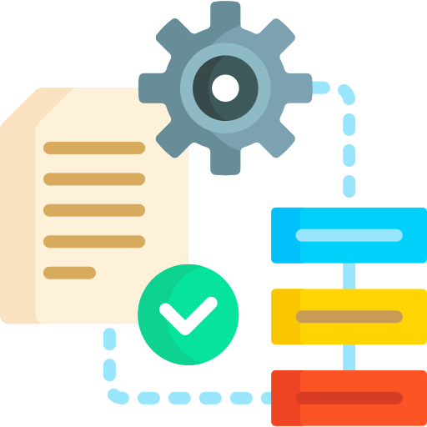
Testing Types at Different Levels
Automated tests are categorised by the level of the testing
Function level
Code file level
User interface level
API level
Notes:
One of the main benefits of using automated testing is that we can comprehensively test the software at different levels
We can test the code at the function level, the file level, the UI level, the API level and even test its integration with other systems
In this section, we are going to discuss some of the common testing types

Slide 10
Common Testing Types
1
5
Unit Testing
Smoke Testing
2
6
Integration Testing
Regression Testing
3
7
Functional Testing
Data Driven Testing
4
…
UI Testing
and more
Notes:
This list represents some of the common testing types. You might have heard of some of them already, like unit testing, integration testing, functional testing, ui testing , smoke testing etc. But don’t be scared, we are not going to learn about all of these in one go.
We will take a closer look at some of the most common ones in the following slides, but do note that this is not a complete list of testing types. There are still a lot of other testing types that we didn’t include here.

Slide 11
Common Testing Types
Commonly Used
1
5
Unit Testing
Smoke Testing
2
6
Integration Testing
Regression Testing
3
7
Functional Testing
Data Driven Testing
4
…
UI Testing
and more
Notes:
The most common testing types you are sure to encounter early in your career as a software developer are unit, integration, functional and ui testing
At a high level, unit testing is done to check individual code pieces, Integration testing is done to validate how code and components are working together. Functional testing is done to validate the whole feature from a user point of view. and UI testing is exactly how it sounds, it involves testing features by mimicking real interactions done via the user interface.
Let’s deep dive into these 4 types of tests one by one.

Slide 12
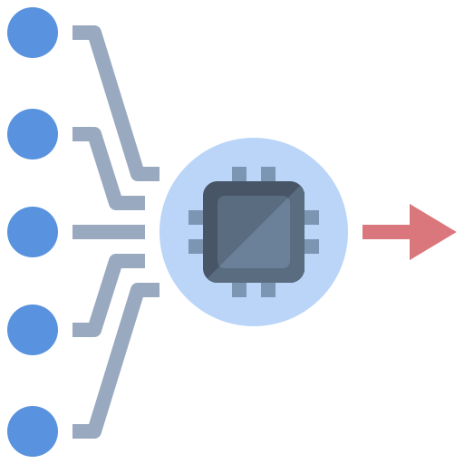
Unit Test
Testing Scope
Smallest logic unit of a piece of software
(usually function)
Testing Method
Pass in different values to a function, and check if the output is the expected value
Notes:
A Unit Test tests the smallest logical piece of software.
Usually this smallest unit is a single “function”. Here, we are talking about the functions in your code, not the function of the software. For example a calculator program may have many functions such as addition, multiplication etc. You should have learnt about functions in the function chapter before when you were learning about JavaScript or Python.
How we test this unit is simple yet critically important for developers to understand. Writing tests may seem difficult at first, but tests often become a developers best friend, as they can save minutes or hours of debugging. So how do we test a unit?
We pass known values into a function, and check if what comes back is what we expected. For example, in the calculator example, if we pass 3 and 4 to the addition function, we expect 7 to come back. If any other number is returned we immediately know that there is a problem with the function logic.
if you have tried the tic-tac-toe project of the JavaScript or python Course before, you should have seen the unit tests that we created for part 1 of the project. And we are going to build more unit tests in our assignment for this chapter.

Slide 13

Integration Test
Testing Scope
Test multiple logical unit together
(e.g. testing multiple functions together, or testing an API)
Testing Method
Call an API or call some top level function, and see if the responses are correct
The API or top level function should be calling a few other functions.
Notes:
Integration tests are used to check that multiple logical units are work well together. we want to see if multiple functions in the code are able to work together to complete a tasks. Sometimes, each function can work well individually but combine them together will cause bugs. That’s y we need integration tests.
So how do we do this?
We will usually call a top level api or some other top level functions which will invoke multiple logical units under the hood in order to come up with a response. SImilar to unit tests, you can pass in known values and assert that the response is correct.

Slide 14

Functional Testing
Testing Scope
Use case, from user’s perspective
(e.g. Test the whole flow of “register a new account” -> “sign in” -> “sign out”, which covered “registration API”, “Sign in API” and “Sign out API”)
Testing Method
Call multiple APIs or top level functions to simulate a users’ interaction with the software
Notes:
Functional testing is sometimes also referred as “use case testing” because it represents a more complete user experience.
These tests are carried out from a users perspective so will often involve multiple api calls to tests a complete feature. After all, whats the point in having an api if you cannot use it for real use cases. The idea behind functional testing is that the API is not useful unless the whole flow is functioning properly.
For example
Instead of testing “login API” and see if it works
we will Test the whole flow of “register a new account”, “sign in” and then “sign out”, which covered “registration API”, “Sign in API” and “Sign out API”
To achieve this we will just call multiple APIs one by one to simulate a workflow.

Slide 15

UI Testing
Testing Scope
User interface (interaction and information displayed)
Testing Method
Use UI automation tools to simulate clicking the buttons on the user interface
Notes:
The final testing types that we want to cover is the User interface testing. As we mentioned before, UI testing is exactly what it sounds like. We are testing the UI. We do this by having the computer clicking real buttons on a real webpage.
This is done through the use of UI browser automation tools
A browser automation tool will open up a browser, and click the button, and type in the information etc. to simulate a human user
Not only can we use these tools to automate interactions, we can also use them to help us validate that the information on UI is correctly displayed by inspecting its content, its style properties, and also its position on the screen.
A lot of these testing types are too difficult and complicated for you at the moment. So don’t worry too much if you don’t know how to build these tests. You only need to have rough understand of these tests for now.
In the next video, we are going to teach you in how to build some unit tests.

Slide 16
Writing Unit Tests in JavaScript
Notes:
In this section, we are going to be hands-on and ook at writing unit tests in javascript.

Slide 17

JavaScript Unit Test
Most programming languages provides a built-in basic unit testing tool
The built-in unit testing tool for JavaScript: assert
Provided by Node.js
No extra installation is needed
Notes:
Because unit testing is such a core and fundamental part of the testing process, most programming languages will provide built in unit testing tools allowing you to quickly develop tests alongside your functional code.
In the case of nodejs, the built in unit testing tool is called assert, no extra installation is required and tests can be extremely concise allowing you to develop powerful tests quickly

Slide 18


Create an Unit Test with Assert
01
02
03
Import the “assert” module
Write down the test cases
Code the test cases with JavaScript and assert
Notes:
So how quick do we mean? Really quick. Writing tests with assert involves three easy steps.
First import the assert module
Next write down the test cases
Finally code the test cases using javascript to invoke the code and pass in the arguments to a function before validating the output using assert

Slide 19
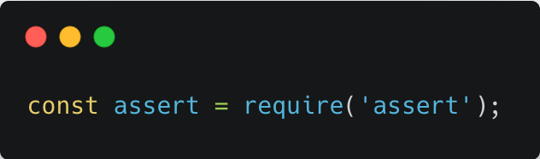
Create an Unit Test with Assert
Step 1: Import the “assert” module
Same as other modules,
we need to import the Node.js module first.
Notes:
Here’s the code snippet of step one, remember how easy we said it would be. You simply require the assert library like what we are doing here. Feel free to copy past this line of code when you are working on the assignment.

Slide 20
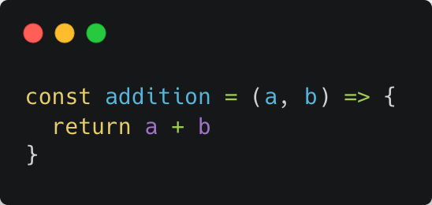
Create an Unit Test with Assert
Step 2: Write down the test cases
Let’s say we are going to design test cases for the function “addition”
The list of test cases we designed
(Each test case should cover a different type scenario)
a | b | Expected Output
1 | 2 | 3
0 | 3 | 3
-5 | 5 | 0
-1 | -2 | -3
+ve and +ve
using 0
-ve and +ve
-ve and -ve
The function “addition”
Notes:
Step 2 is to write down the test cases of the function that you want to test.
We spoke earlier about how a calculator might have multiple functions, and how one of those functions would be the addition function which takes two parameters as the input and returns a single number as the output.
But lets think about this, how do you know if the calculator addition function is working? Is a single test enough? If you pass in 3 and 4 and it returns a 7, is that enough to confirm the function works? What if the function is built to return 7 no matter what the inputs are?
We need to think about multiple use cases and determine what the outcome should be so that we can confirm it all works as expected. In this example we consider what if two positive numbers are passed in, what about if one of the numbers is zero? What is one positive and one negative number is given? And finally what if two negative numbers are passed in? This is a pretty comprehensive suite of tests, and we can be relatively sure that if all of the expected outcomes are returned, then the code logic is sound
Usually , we will use a table to list out all the test cases that we can think of.

Slide 21
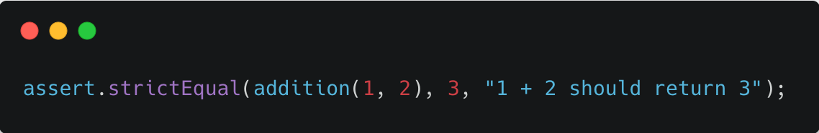
Create an Unit Test with Assert
Step 3: Code the test cases with JavaScript and assert
Test Case Syntax
Validation Method
Test Case
Error message if test case is failed
Expected Output
Notes:
Then we are at step 3. We can finally start writing test in javascript.
This code snippet here shows the syntax or structure of an simple assert test. Its not a lot of code, but its actually quite elegant and powerful,
First we select a validation function from the assert library, in this case it is the strictEqual function. It is for doing simple comparisons. this assertion function takes three arguments, the first argument is the test case that we want to test, the second argument is the expected output, and the final argument is an error message which will be returned if the test result and expected value do not match. This helps us to quickly identify exactly which test has gone wrong if any of them fail.

Slide 22
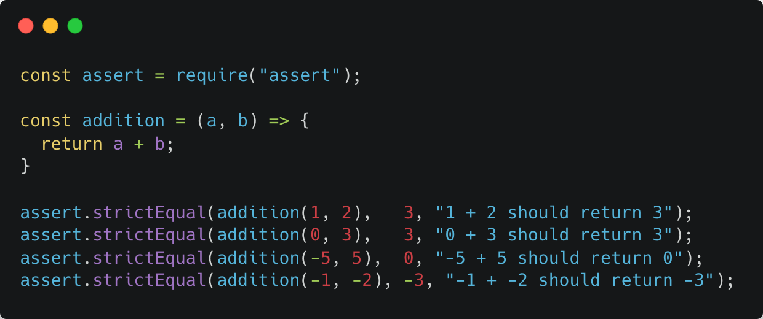
Create an Unit Test with Assert
Step 3: Code the test cases with JavaScript and assert
In this step, we are going to convert the test cases to code
The list of test cases we designed
a | b | Expected Output
1 | 2 | 3
0 | 3 | 3
-5 | 5 | 0
-5 | -5 | -10
The test cases
Computer will execute this part and collect the return value
Notes:
Lets jump back to the list of test cases we designed earlier, and let’s turn each one into a piece of code that will validate each case.
In the screenshot you can see that we have required the assert library and defined the addition function.
We have then defined a number of unique test cases which will each test a different test case of the addition function.
the first assertion test here is corresponding to the first test case in the table. 1 and 2 will test what happens is two positive numbers are used
Similarly, the second, third and forth assertion tests here corresponding to the 2nd, 3rd and 4th test case in the table.
0 and 3 will test what happens if one of the inputs is zero
-5 and 5 tests our code if a mixture of positive and negative numbers are used
And finally -5 and -5 tests what happens if both inputs are negative numbers
You can see that we have highlighted the test cases here.

Slide 23
Create an Unit Test with Assert
Step 3: Code the test cases with JavaScript and assert
In this step, we are going to convert the test cases to code
The list of test cases we designed
a | b | Expected Output
1 | 2 | 3
0 | 3 | 3
-5 | 5 | 0
-5 | -5 | -10
Expected Output
Notes:
Alongside each test case you will see the expected outcomes for each test case

Slide 24
Create an Unit Test with Assert
Step 3: Code the test cases with JavaScript and assert
In this step, we are going to convert the test cases to code
The list of test cases we designed
a | b | Expected Output
1 | 2 | 3
0 | 3 | 3
-5 | 5 | 0
-5 | -5 | -10
Error message if test not passing
Notes:
Finally, if any of the tests fail, a unique error message will help us to immediately identify which one it was.
In just 4 lines of code we have comprehensively tested the multiple use cases of our addition feature. It’s easy, right? lets go to a demo and see it in practice
(Demo for writing test case for a simple function like “addition”)

Slide 25
4 Common Validation Methods
Assertion Function | Function
assert.StrictEqual() | Test for equals
assert.notStrictEqual() | Test for not equals (Note: Same value but different type would be passing the test, i.e. assert.notStrictEqual(1, '1') will pass the test)
assert.deepStrictEqual() | Test for arrays and objects results (Note: strictEqual won’t work for array and object)
assert.notDeepStrictEqual() | Test for not equal for arrays and objects
Notes:
Up until now we have been testing by checking for equality using strictEqual but there are a range of other validation methods available to us to make testing our software easier.
(the points should show up one by one)
NotStrictEqual is the opposite to strictEqual and makes sure that the value returned from the function under testing does not match a particular value.
Similarly deepStrictEqual and notDeepStrictEqual same as the other 2, just that they are used to test object and array equality and inequality respectively. If you are trying to test for arrays and objects, make sure you use the deep version of assertion method.
There are also other assertion methods not listed out here. If you are interested, feel free to check out the assert documentation for the more types of assertions and choose the ones that work well for your tests.

Slide 26
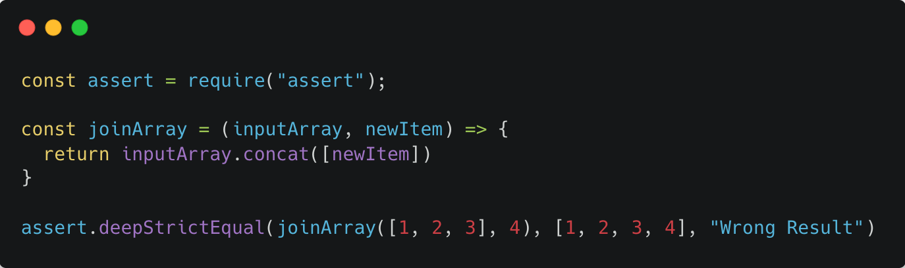
Asserting Objects and Arrays
Expected output is an array
Make sure you use “deepStrictEqual” to assert for array and object results
Notes:
We have been saying that if you want to test for arrays and objects, you will need to use the deep version of the assertion method.
Lets jump back to our demo and show how we would use deepStrictEqual to test a function that returns an array
(demo for writing a test for asserting array using normal strictEqual and deepStrictEqual, to show them that the output would be incorrect if they are not using deepStrictEqual)
Now that you’ve seen test cases in action, its time for you to try them yourself. In the next assignment you’ll be writing and implementing real test cases using javascript assert.
I’m happy to tell you that this concludes the module. You now have all the basic knowledge and a foundation of essential skills required for a successful career in software engineering. You should be comfortable with best practices of git and github, you should have a basic understanding of cloud computing and software project management, and you can now write basic unit tests with a strong understanding of the part they take in the field of test automation.
I hope you’ve learned a lot and enjoyed the journey, and I wish you all the best in your software engineering career.

